Slide 1
Mapping of US 7,062,510 on Experian Purchase-Based Data Solutions
Field 1: Patent Number
US Application 9/807,887
Priority 12/02/1999

Slide 2
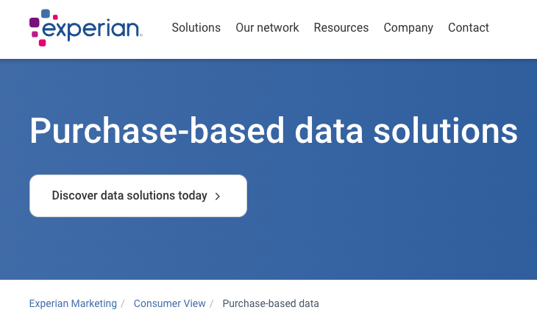
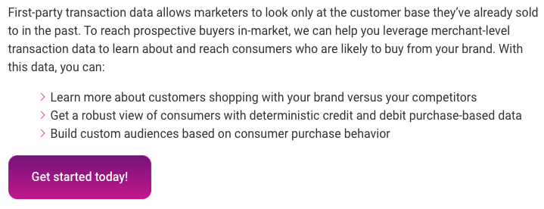
Field 2: Claim Number
Multiple claims per patent number but team will only focus on one or two
Field 9 and 10: Company and Product
Company and product that are likely infringing
Field 5: Evidence 1
Screenshots or copy/pastes from company-official websites, documentation, APIs, SDKs, presentations, youtube videos (no embeded video, just url), etc. demonstrating evidence of use/infringement
Claim 1:
A method for profiling a consumer based on consumer purchases, said method comprising the steps of:
Student Commentary
This is where students will give their viewpoint on (1) why they believe there is infringement and (2) how they know or would know, either (a) it’s the only way it could be done technically, or (b) we’d need to have XYZ (source code, whatever) to be able to prove it.
Field 8: Comments
Field 3: Claim Preamble
Field 7: Source
This is really “5a and 6a” in the sense that the URL ties to both. But in some cases each of 5 and 6 will have their own URLS.
https://www.experian.com/marketing/consumer-view/transactional-data#transactional
Field 6: Evidence 2
Some ”evidence” will include more than one screen capture. And we will want them to highlight the specific parts that they believe are showing infringement

Slide 3
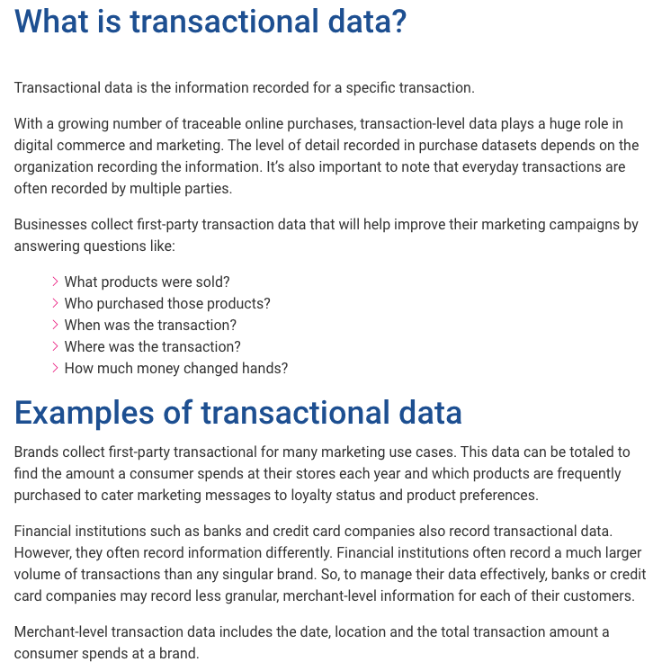
(a) receiving a computer-readable detailed purchase record of said consumer wherein said computer-readable detailed purchase record has an associated unique consumer identification;
Field 4: Claim Limitation (aka “Element”)
These will end up in the same “column” in the EoUs and Claim Charts
https://www.experian.com/marketing/consumer-view/transactional-data#transactional

Slide 4
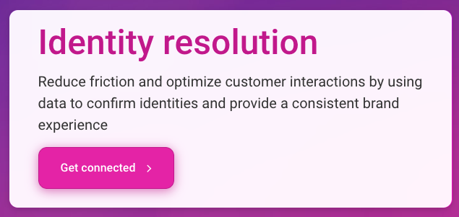
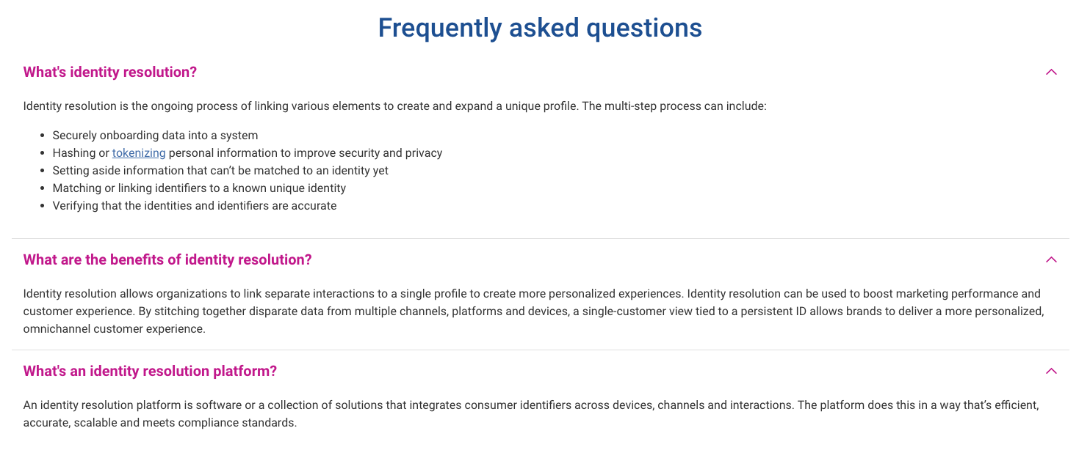
(a) receiving a computer-readable detailed purchase record of said consumer wherein said computer-readable detailed purchase record has an associated unique consumer identification;
https://www.experian.com/business/solutions/identity-solutions/identity-resolution-services#contac

Slide 5
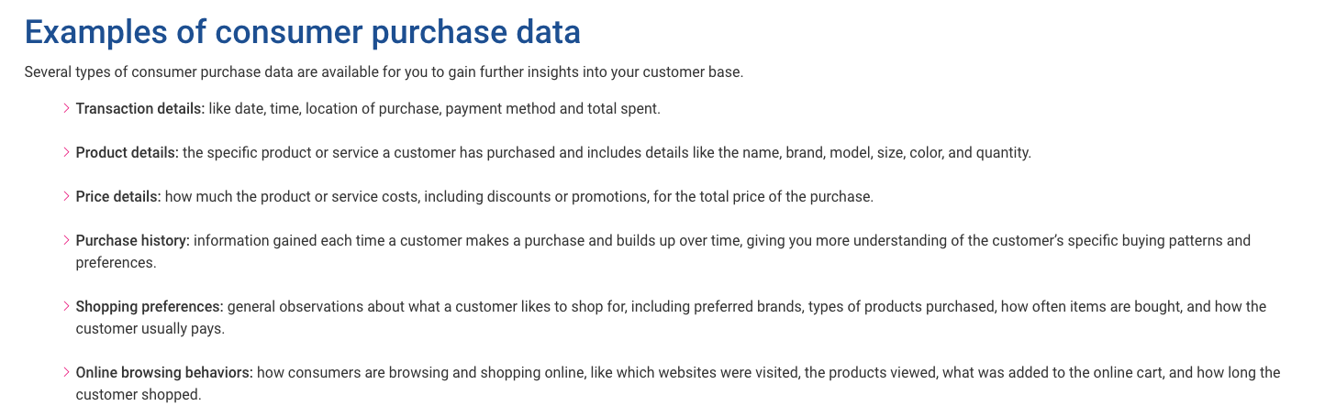
(b) retrieving product characterization information;
https://www.experian.com/marketing/consumer-view/transactional-data#contactForm

Slide 6
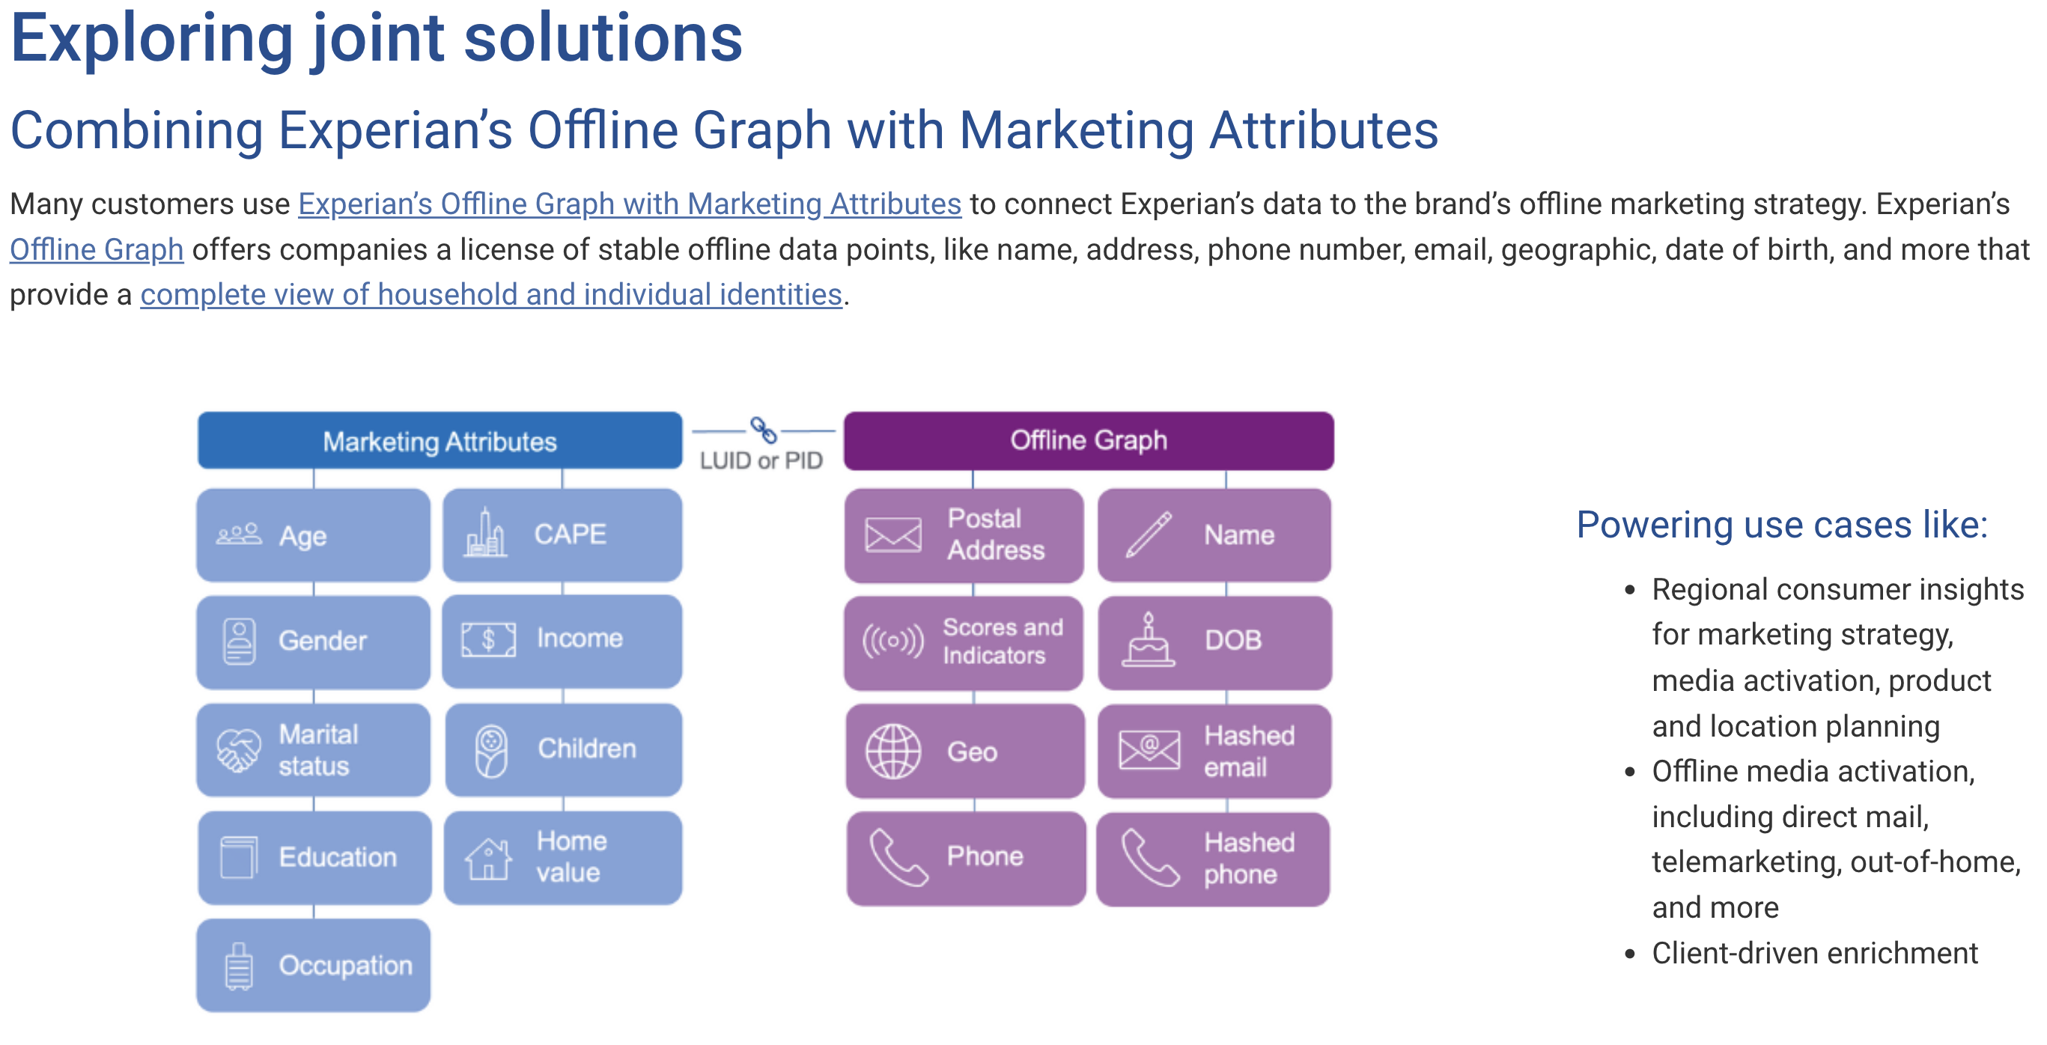
(c) calculating a consumer characterization vector from said computer-readable detailed purchase record and said product characterization information; and
https://www.experian.com/blogs/marketing-forward/practical-applications-of-experians-marketing-attributes/

Slide 7
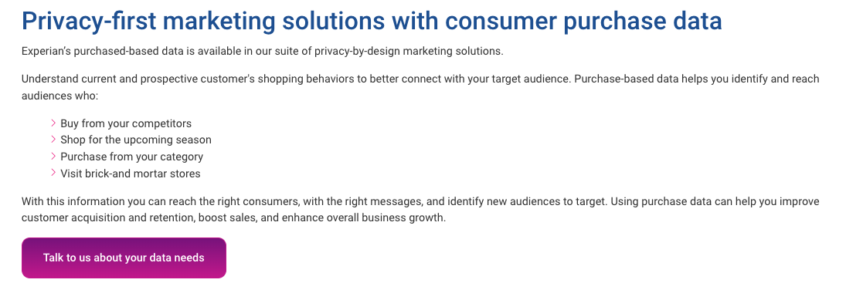
(d) storing said consumer characterization vector on a computer-readable medium.
https://www.experian.com/marketing/consumer-view/transactional-data#contactForm

